Slide 1
Denoising Diffusion Probabilistic Models (DDPMs)
Presented by
MEDIOCRE_GUY
April 4, 2024

Slide 2







Introduction (1/2)
In simple terms, two processes happen in denoising diffusion probabilistic models (DDPMs):
The data structure is destroyed by gradually adding Gaussian noise over a finite number of time steps to end up with pure noise (forward/diffusion process)
A neural network is trained to gradually denoise the data starting from pure noise and predict a distribution that looks like the original distribution (reverse/denoising process)
Forward/diffusion process
Reverse/denoising process
$$x_{0}$$
$$x_{1}$$
…..
$$x_{T−1}$$
$$x_{T}$$
Original data
Pure noise
$${p_{0}(x}_{0})$$
Becomes noise (in the forward process)
$${p_{T}(x}_{T})$$
Turns into data (in the reverse process)

Slide 3
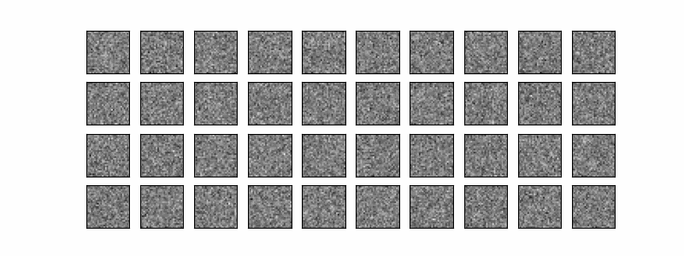
Introduction (2/2)
The objective of using diffusion models is to successfully generate actual images from pure noise only if they are trained well
Source: https://github.com/TeaPearce/Conditional_Diffusion_MNIST

Slide 4
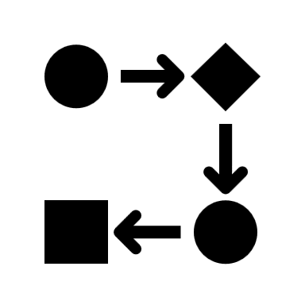
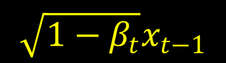
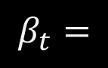
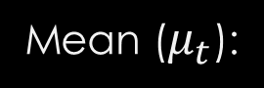
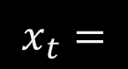

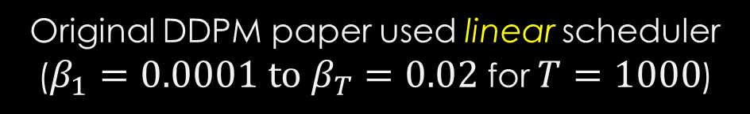
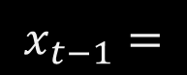
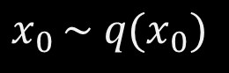
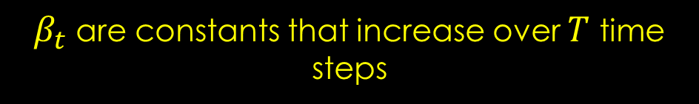

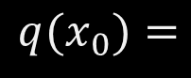
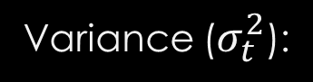
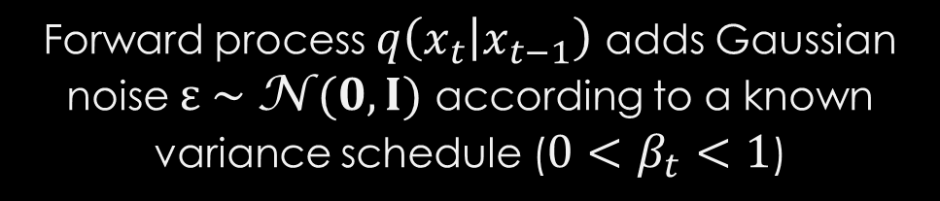
Forward (Diffusion) Process (1/2)
$${q(x}_{0})=$$
Original data distribution
$$q\left(x_{t} | x_{t−1}\right)=\text{N} (x_{t}; \sqrt{1−β_{t}}x_{t−1}, β_{t}I)$$
$$x_{0 }\sim q(x_{0})$$
Forward process
Mean ($μ_{t}$):
$$\sqrt{1−β_{t}}x_{t−1}$$
Taking a sample from the original data distribution
Variance ($σ_{t}^{2}$):
$$β_{t}$$
$$x_{t−1}=$$
Less noisy image
$$x_{t}=$$
More noisy image
$$β_{t}=$$
Variance scheduler (linear, cosine, sigmoid, quadratic etc.)
Forward process $q\left(x_{t} | x_{t−1}\right)$ adds Gaussian noise $ε \sim \text{N} (0, I)$ according to a known variance schedule ($0<β_{t}<1$)
$β_{t}$ are constants that increase over $T$ time steps
The source image ($x_{0}$) eventually turns into pure noise ($x_{T}$) through the forward process
Original DDPM paper used linear scheduler ($β_{1}=0.0001 to β_{T}=0.02$ for $T=1000$)
Source: https://arxiv.org/pdf/2006.11239.pdf

Slide 5



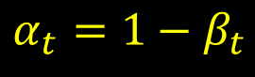
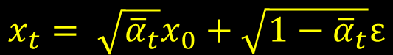



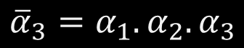


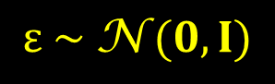
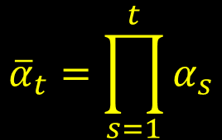
Forward (Diffusion) Process (2/2)
$$q\left(x_{t} | x_{t−1}\right)=\text{N} (x_{t}; \sqrt{1−β_{t}}x_{t−1}, β_{t}I)$$
A single step of the forward process
$$q\left(x_{1:T} | x_{0}\right)=\prod_{t=1}^{T}{q\left(x_{t} | x_{t−1}\right)}$$
Equation for the full forward process
Reparameterization trick
$$\text{N} \left(μ,σ^{2}\right)=μ+σ \text{⊙} ε$$
$⊙$ → Element-wise product
$$x_{t}= \sqrt{1−β_{t}}x_{t−1}+\sqrt{β_{t}}ε$$
$$ε \sim \text{N} (0, I)$$
$$x_{t}= \sqrt{{\overline{α}}_{t}}x_{0}+\sqrt{1−{\overline{α}}_{t}}ε$$
$$= \sqrt{α_{t}}x_{t−1}+\sqrt{{1−α}_{t}}ε$$
$$α_{t}=1−β_{t}$$
$$q\left(x_{t} | x_{0}\right)=\text{N} \left(x_{t}; \sqrt{{\overline{α}}_{t}}x_{0},\left(1−{\overline{α}}_{t}\right)I\right)$$
$$= \sqrt{α_{t}α_{t−1}}x_{t−2}+\sqrt{{1−α}_{t}α_{t−1}}ε$$
This allows to sample $x_{t}$ at any time step $t$ conditioned on $x_{0}$
…..
$${\overline{α}}_{t}=\prod_{s=1}^{t}{α_{s}}$$
$$= \sqrt{{\overline{α}}_{t}}x_{0}+\sqrt{1−{\overline{α}}_{t}}ε$$
For example,
$${\overline{α}}_{3}=α_{1}.α_{2}.α_{3}$$
Source: https://arxiv.org/pdf/2006.11239.pdf

Slide 6
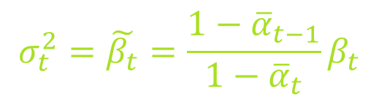

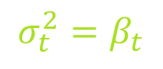

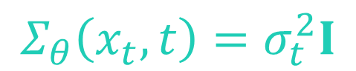
Reverse (Denoising) Process (1/15)
$$p\left(x_{t−1} | x_{t}\right)$$
The reverse process can not executed like the forward process because it requires knowing the distribution of all the images in order, which is impossible
Reverse process
Hence, a neural network is used to approximate the denoising part
$$p_{θ}\left(x_{t−1} | x_{t}\right)$$
$θ$ → all the parameters of the neural network
$$p_{θ}\left(x_{t−1} | x_{t}\right)=\text{N} \left(x_{t−1}; μ_{θ}\left(x_{t},t\right),Σ_{θ}\left(x_{t},t\right)\right)$$
Both the mean ($μ_{θ}$) and the variance ($Σ_{θ}$) are conditioned on the noise level (time step) $t$
In the original DDPM paper, the authors kept the variance ($Σ_{θ}$) fixed and used one neural network to learn only the mean ($μ_{θ}$)
$$σ_{t}^{2}=β_{t}$$
DDPM authors claimed that both choices yielded similar results
$$Σ_{θ}\left(x_{t},t\right)=σ_{t}^{2}I$$
$$σ_{t}^{2}=\tilde{β_{t}}=\frac{1−{\overline{α}}_{t−1}}{1−{\overline{α}}_{t}}β_{t}$$
Source: https://arxiv.org/pdf/2006.11239.pdf

Slide 7

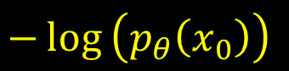
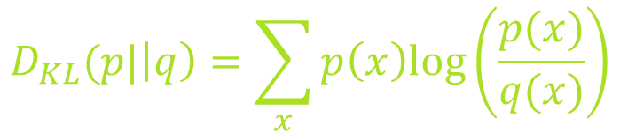
Reverse (Denoising) Process (2/15)
To learn the mean ($μ_{θ}$), the DDPM authors decided to minimize the negative log-likelihood (NLL) regarding the source image as their objective function
$$−\log\left(p_{θ}\left(x_{0}\right)\right)$$
Not computable
So, the DDPM authors chose to compute the variational lower bound (VLB) instead
Have to keep track of $T−1$ other random variables $(x_{T},x_{T−1},x_{T−2},…,x_{3},x_{2},x_{1})$
$$−log\left(p_{θ}\left(x_{0}\right)\right)≤−log\left(p_{θ}\left(x_{0}\right)\right)+D_{KL}\left(q\left(x_{1:T} | x_{0}\right)||p_{θ}\left(x_{1:T} | x_{0}\right)\right)$$
KL divergence:
$$D_{KL}(p|\left|q\right)=\sum_{x}{p\left(x\right)log⁡\left(\frac{p(x)}{q(x)}\right)}$$
Needs to be minimized
Source: https://arxiv.org/pdf/2006.11239.pdf

Slide 8
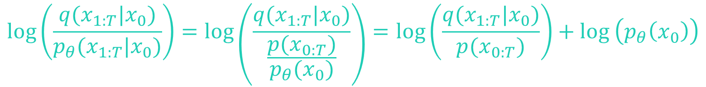

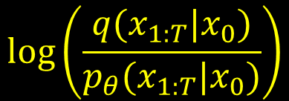
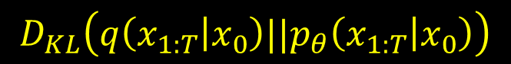
Reverse (Denoising) Process (3/15)
$$log\left(\frac{q(x_{1:T}|x_{0})}{p_{θ}(x_{1:T}|x_{0})}\right)$$
$$D_{KL}\left(q\left(x_{1:T} | x_{0}\right)||p_{θ}\left(x_{1:T} | x_{0}\right)\right)$$
Joint probability
$$p_{θ}\left(x_{1:T} | x_{0}\right)=\frac{p_{θ}\left(x_{0} | x_{1:T}\right)p_{θ}(x_{1:T})}{p_{θ}(x_{0})}=\frac{p_{θ}(x_{0},x_{1:T})}{p_{θ}(x_{0})}=\frac{p(x_{0:T})}{p_{θ}(x_{0})}$$
Bayes’ rule
$$log\left(\frac{q(x_{1:T}|x_{0})}{p_{θ}(x_{1:T}|x_{0})}\right)=log\left(\frac{q(x_{1:T}|x_{0})}{\frac{p(x_{0:T})}{p_{θ}(x_{0})}}\right)=log\left(\frac{q(x_{1:T}|x_{0})}{p(x_{0:T})}\right)+\log\left(p_{θ}\left(x_{0}\right)\right)$$
Log product rule
$$−log\left(p_{θ}\left(x_{0}\right)\right)≤−log\left(p_{θ}\left(x_{0}\right)\right)+D_{KL}\left(q\left(x_{1:T} | x_{0}\right)||p_{θ}\left(x_{1:T} | x_{0}\right)\right)$$
now becomes
Source: https://arxiv.org/pdf/2006.11239.pdf

Slide 9


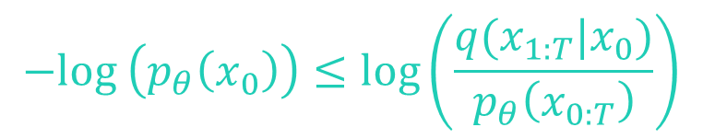

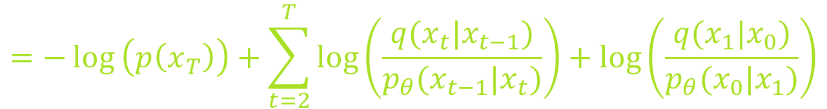
Reverse (Denoising) Process (4/15)
$$−log\left(p_{θ}\left(x_{0}\right)\right)≤−log\left(p_{θ}\left(x_{0}\right)\right)+log\left(\frac{q(x_{1:T}|x_{0})}{p_{θ}\left(x_{0:T}\right)}\right)+\log\left(p_{θ}\left(x_{0}\right)\right)$$
$$−log\left(p_{θ}\left(x_{0}\right)\right)≤log\left(\frac{q(x_{1:T}|x_{0})}{p_{θ}\left(x_{0:T}\right)}\right)$$
Variational Lower Bound (VLB)
$q(x_{1:T}|x_{0})$is the forward process
$$p_{θ}\left(x_{0:T}\right)=p(x_{T})\prod_{t=1}^{T}{p_{θ}(x_{t−1}|x_{t})}$$
$$log\left(\frac{q(x_{1:T}|x_{0})}{p_{θ}\left(x_{0:T}\right)}\right)=log\left(\frac{\prod_{t=1}^{T}{q\left(x_{t} | x_{t−1}\right)}}{p(x_{T})\prod_{t=1}^{T}{p_{θ}\left(x_{t−1} | x_{t}\right)}}\right)=−\log\left(p\left(x_{T}\right)\right)+\sum_{t=1}^{T}{log\left(\frac{q(x_{t}|x_{t−1})}{p_{θ}(x_{t−1}|x_{t})}\right)}$$
$$=−\log\left(p\left(x_{T}\right)\right)+\sum_{t=2}^{T}{log\left(\frac{q(x_{t}|x_{t−1})}{p_{θ}(x_{t−1}|x_{t})}\right)+log\left(\frac{q(x_{1}|x_{0})}{p_{θ}(x_{0}|x_{1})}\right)}$$
Source: https://arxiv.org/pdf/2006.11239.pdf

Slide 10
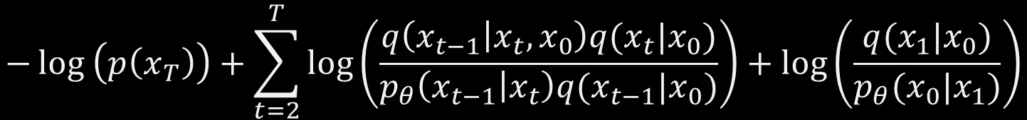

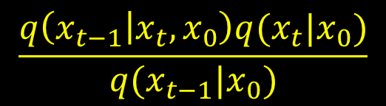
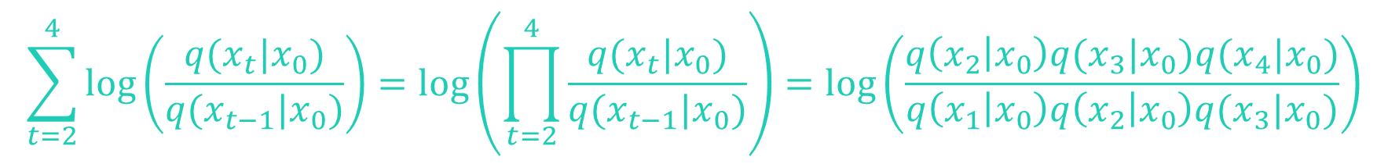
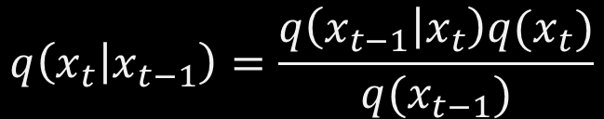
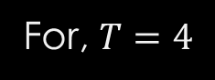
Reverse (Denoising) Process (5/15)
$$q\left(x_{t} | x_{t−1}\right)=\frac{q\left(x_{t−1} | x_{t}\right)q(x_{t})}{q(x_{t−1})}$$
According to Bayes’ rule
The DDPM authors decided to condition this on $x_{0}$ (trick)
$$\frac{q\left(x_{t−1} | x_{t},x_{0}\right)q(x_{t}|x_{0})}{q(x_{t−1}|x_{0})}$$
So, VLB becomes
$$−\log\left(p\left(x_{T}\right)\right)+\sum_{t=2}^{T}{log\left(\frac{q\left(x_{t−1} | x_{t},x_{0}\right)q(x_{t}|x_{0})}{p_{θ}\left(x_{t−1} | x_{t}\right)q(x_{t−1}|x_{0})}\right)+log\left(\frac{q(x_{1}|x_{0})}{p_{θ}(x_{0}|x_{1})}\right)}$$
$$=−\log\left(p\left(x_{T}\right)\right)+\sum_{t=2}^{T}{log\left(\frac{q\left(x_{t−1} | x_{t},x_{0}\right)}{p_{θ}\left(x_{t−1} | x_{t}\right)}\right)+\sum_{t=2}^{T}{log\left(\frac{q(x_{t}|x_{0})}{q(x_{t−1}|x_{0})}\right)}+log\left(\frac{q(x_{1}|x_{0})}{p_{θ}(x_{0}|x_{1})}\right)}$$
$$\sum_{t=2}^{4}{log\left(\frac{q(x_{t}|x_{0})}{q(x_{t−1}|x_{0})}\right)=log\left(\prod_{t=2}^{4}{\frac{q(x_{t}|x_{0})}{q(x_{t−1}|x_{0})}}\right)=log\left(\frac{q\left(x_{2} | x_{0}\right)q(x_{3}|x_{0})q(x_{4}|x_{0})}{q\left(x_{1} | x_{0}\right)q\left(x_{2} | x_{0}\right)q(x_{3}|x_{0})}\right)}$$
For, $T=4$
Source: https://arxiv.org/pdf/2006.11239.pdf

Slide 11
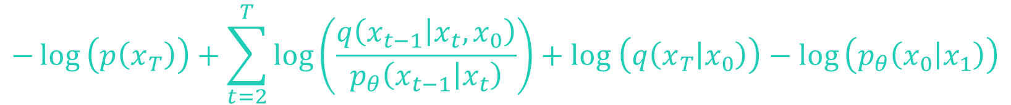
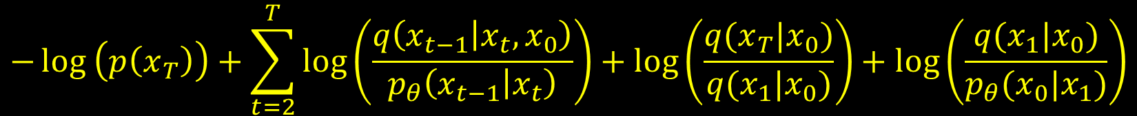

Reverse (Denoising) Process (6/15)
Eventually, we obtain
$$\sum_{t=2}^{T}{log\left(\frac{q(x_{t}|x_{0})}{q(x_{t−1}|x_{0})}\right)=log\left(\frac{q(x_{T}|x_{0})}{q(x_{1}|x_{0})}\right)}$$
Hence, VLB becomes
$$−\log\left(p\left(x_{T}\right)\right)+\sum_{t=2}^{T}{log\left(\frac{q\left(x_{t−1} | x_{t},x_{0}\right)}{p_{θ}\left(x_{t−1} | x_{t}\right)}\right)+log\left(\frac{q(x_{T}|x_{0})}{q(x_{1}|x_{0})}\right)+log\left(\frac{q(x_{1}|x_{0})}{p_{θ}(x_{0}|x_{1})}\right)}$$
Log division rule gives us
$$\log\left(q\left(x_{T} | x_{0}\right)\right)−\log\left(q\left(x_{1} | x_{0}\right)\right)+\log\left(q\left(x_{1} | x_{0}\right)\right)−\log\left(p_{θ}\left(x_{0} | x_{1}\right)\right)$$
$$−\log\left(p\left(x_{T}\right)\right)+\sum_{t=2}^{T}{log\left(\frac{q\left(x_{t−1} | x_{t},x_{0}\right)}{p_{θ}\left(x_{t−1} | x_{t}\right)}\right)+log \left(q\left(x_{T} | x_{0}\right)\right)−log}\left(p_{θ}\left(x_{0} | x_{1}\right)\right)$$
Source: https://arxiv.org/pdf/2006.11239.pdf

Slide 12
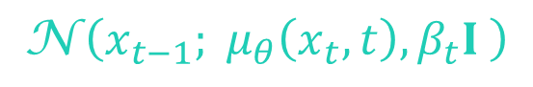



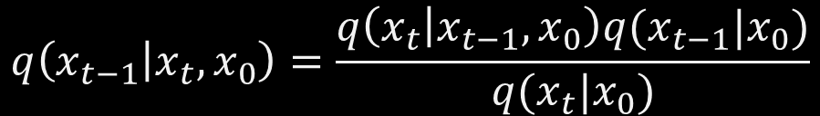
Reverse (Denoising) Process (7/15)
Simplification results in
$$log\left(\frac{q(x_{T}|x_{0})}{p(x_{T})}\right)+\sum_{t=2}^{T}{log\left(\frac{q\left(x_{t−1} | x_{t},x_{0}\right)}{p_{θ}\left(x_{t−1} | x_{t}\right)}\right)−log}\left(p_{θ}\left(x_{0} | x_{1}\right)\right)$$
$$D_{KL}\left(q\left(x_{T} | x_{0}\right)||p\left(x_{T}\right)\right)+\sum_{t=2}^{T}{D_{KL}\left(q\left(x_{t−1} | x_{t},x_{0}\right)||p_{θ}\left(x_{t−1} | x_{t}\right)\right)−\log\left(p_{θ}\left(x_{0} | x_{1}\right)\right)}$$
This part has no learnable parameters
$$\text{N} \left(x_{t−1}; {\tilde{μ}}_{t}\left(x_{t},x_{0}\right), {\tilde{β}}_{t}I \right)$$
$$\text{N} \left(x_{t−1}; μ_{θ}\left(x_{t},t\right),β_{t}I \right)$$
$$q\left(x_{t−1} | x_{t},x_{0}\right)=\frac{q\left(x_{t} | x_{t−1},x_{0}\right)q(x_{t−1}|x_{0})}{q(x_{t}|x_{0})}$$
Bayes’ rule
Source: https://arxiv.org/pdf/2006.11239.pdf

Slide 13
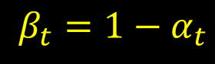
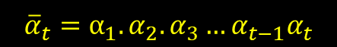
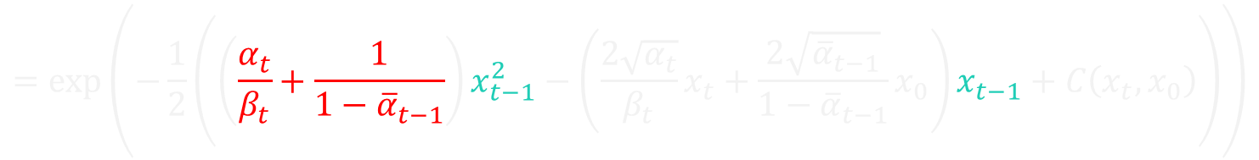
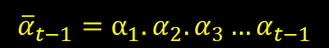

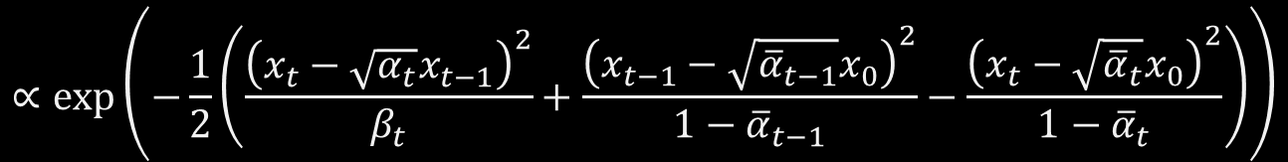
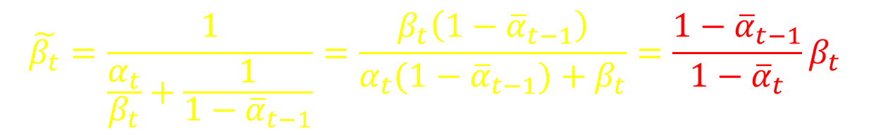
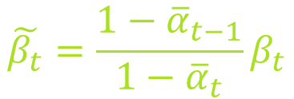
Reverse (Denoising) Process (8/15)
$$∝exp⁡\left(−\frac{1}{2}\left(\frac{{\left(x_{t}−\sqrt{α_{t}}x_{t−1}\right)}^{2}}{β_{t}}+\frac{{\left(x_{t−1}−\sqrt{{\overline{α}}_{t−1}}x_{0}\right)}^{2}}{1−{\overline{α}}_{t−1}}−\frac{{\left(x_{t}−\sqrt{{\overline{α}}_{t}}x_{0}\right)}^{2}}{1−{\overline{α}}_{t}}\right)\right)$$
$$=exp⁡\left(−\frac{1}{2}\left(\frac{x_{t}^{2}−2\sqrt{α_{t}}x_{t}x_{t−1}+α_{t}x_{t−1}^{2}}{β_{t}}+\frac{x_{t−1}^{2}−2\sqrt{{\overline{α}}_{t−1}}x_{0}x_{t−1}+{\overline{α}}_{t−1}x_{0}^{2}}{1−{\overline{α}}_{t−1}}−\frac{{\left(x_{t}−\sqrt{{\overline{α}}_{t}}x_{0}\right)}^{2}}{1−{\overline{α}}_{t}}\right)\right)$$
$$=exp⁡\left(−\frac{1}{2}\left(\left(\frac{α_{t}}{β_{t}}+\frac{1}{1−{\overline{α}}_{t−1}}\right)x_{t−1}^{2}−\left(\frac{2\sqrt{α_{t}}}{β_{t}}x_{t}+\frac{2\sqrt{{\overline{α}}_{t−1}}}{1−{\overline{α}}_{t−1}}x_{0}\right)x_{t−1}+C\left(x_{t},x_{0}\right)\right)\right)$$
$$β_{t}=1−α_{t}$$
$${\overline{α}}_{t}=\prod_{s=1}^{t}{α_{s}}$$
$$\tilde{β_{t}}=\frac{1}{\frac{α_{t}}{β_{t}}+\frac{1}{1−{\overline{α}}_{t−1}}}=\frac{β_{t}\left(1−{\overline{α}}_{t−1}\right)}{α_{t}(1−{\overline{α}}_{t−1})+β_{t}}=\frac{1−{\overline{α}}_{t−1}}{1−{\overline{α}}_{t}}β_{t}$$
$${\overline{α}}_{t−1}=α_{1}.α_{2}.α_{3}…α_{t−1}$$
$$\tilde{β_{t}}=\frac{1−{\overline{α}}_{t−1}}{1−{\overline{α}}_{t}}β_{t}$$
$${\overline{α}}_{t}=α_{1}.α_{2}.α_{3}…α_{t−1}α_{t}$$
Source: https://arxiv.org/pdf/2006.11239.pdf

Slide 14
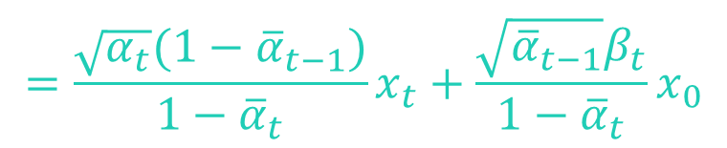
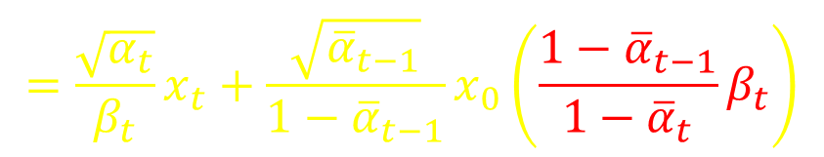
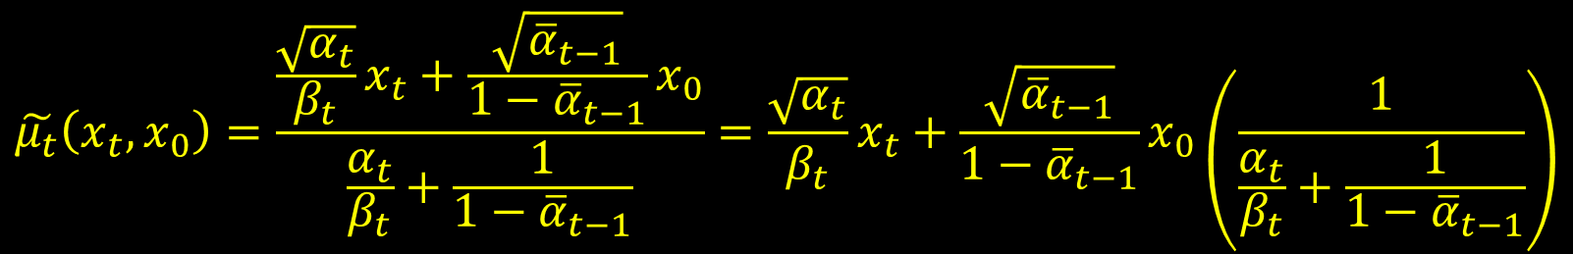
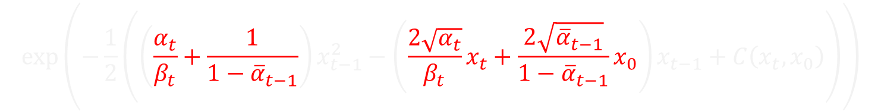
Reverse (Denoising) Process (9/15)
$$exp⁡\left(−\frac{1}{2}\left(\left(\frac{α_{t}}{β_{t}}+\frac{1}{1−{\overline{α}}_{t−1}}\right)x_{t−1}^{2}−\left(\frac{2\sqrt{α_{t}}}{β_{t}}x_{t}+\frac{2\sqrt{{\overline{α}}_{t−1}}}{1−{\overline{α}}_{t−1}}x_{0}\right)x_{t−1}+C\left(x_{t},x_{0}\right)\right)\right)$$
$$\tilde{μ_{t}}\left(x_{t},x_{0}\right)=\frac{\frac{\sqrt{α_{t}}}{β_{t}}x_{t}+\frac{\sqrt{{\overline{α}}_{t−1}}}{1−{\overline{α}}_{t−1}}x_{0}}{\frac{α_{t}}{β_{t}}+\frac{1}{1−{\overline{α}}_{t−1}}}=\frac{\sqrt{α_{t}}}{β_{t}}x_{t}+\frac{\sqrt{{\overline{α}}_{t−1}}}{1−{\overline{α}}_{t−1}}x_{0}\left(\frac{1}{\frac{α_{t}}{β_{t}}+\frac{1}{1−{\overline{α}}_{t−1}}}\right)$$
$$=\frac{\sqrt{α_{t}}}{β_{t}}x_{t}+\frac{\sqrt{{\overline{α}}_{t−1}}}{1−{\overline{α}}_{t−1}}x_{0}\left(\frac{1−{\overline{α}}_{t−1}}{1−{\overline{α}}_{t}}β_{t}\right)$$
$$=\frac{\sqrt{α_{t}}(1−{\overline{α}}_{t−1})}{1−{\overline{α}}_{t}}x_{t}+\frac{\sqrt{{\overline{α}}_{t−1}}β_{t}}{1−{\overline{α}}_{t}}x_{0}$$
Source: https://arxiv.org/pdf/2006.11239.pdf

Slide 15
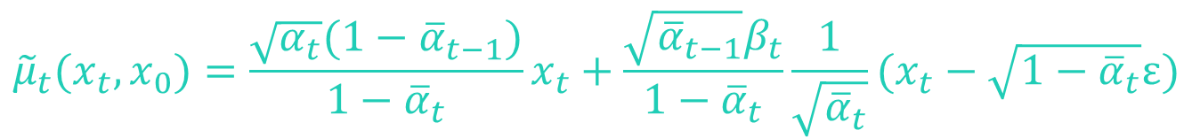
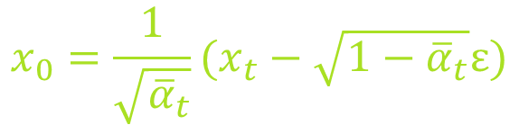




Reverse (Denoising) Process (10/15)
$${\tilde{μ}}_{t}\left(x_{t},x_{0}\right)=\frac{\sqrt{α_{t}}(1−{\overline{α}}_{t−1})}{1−{\overline{α}}_{t}}x_{t}+\frac{\sqrt{{\overline{α}}_{t−1}}β_{t}}{1−{\overline{α}}_{t}}x_{0}$$
From forward process →
$$x_{t}= \sqrt{{\overline{α}}_{t}}x_{0}+\sqrt{1−{\overline{α}}_{t}}ε$$
$$x_{0}=\frac{1}{\sqrt{{\overline{α}}_{t}}}(x_{t}−\sqrt{1−{\overline{α}}_{t}}ε)$$
$${\tilde{μ}}_{t}(x_{t},x_{0})=\frac{\sqrt{α_{t}}(1−{\overline{α}}_{t−1})}{1−{\overline{α}}_{t}}x_{t}+\frac{\sqrt{{\overline{α}}_{t−1}}β_{t}}{1−{\overline{α}}_{t}}\frac{1}{\sqrt{{\overline{α}}_{t}}}(x_{t}−\sqrt{1−{\overline{α}}_{t}}ε)$$
$$=\left[\frac{\sqrt{α_{t}}(1−{\overline{α}}_{t−1})}{1−{\overline{α}}_{t}}+\frac{\sqrt{{\overline{α}}_{t−1}}β_{t}}{\sqrt{{\overline{α}}_{t}}\left(1−{\overline{α}}_{t}\right)}\right]x_{t}−\frac{\sqrt{{\overline{α}}_{t−1}}β_{t}\sqrt{1−{\overline{α}}_{t}}}{\sqrt{{\overline{α}}_{t}}\left(1−{\overline{α}}_{t}\right)}ε$$
$$=Ax_{t}−Bε$$
Source: https://arxiv.org/pdf/2006.11239.pdf

Slide 16










Reverse (Denoising) Process (11/15)
$$A=\frac{\sqrt{α_{t}}(1−{\overline{α}}_{t−1})}{1−{\overline{α}}_{t}}+\frac{\sqrt{{\overline{α}}_{t−1}}β_{t}}{\sqrt{{\overline{α}}_{t}}\left(1−{\overline{α}}_{t}\right)}=\frac{\sqrt{{\overline{α}}_{t}}\sqrt{α_{t}}\left(1−{\overline{α}}_{t−1}\right)+\sqrt{{\overline{α}}_{t−1}}\left(1−α_{t}\right)}{\sqrt{{\overline{α}}_{t}}\left(1−{\overline{α}}_{t}\right)}$$
$$β_{t}=1−α_{t}$$
$$=\frac{\sqrt{{α_{t}\overline{α}}_{t−1}}\sqrt{α_{t}}\left(1−{\overline{α}}_{t−1}\right)+\sqrt{{\overline{α}}_{t−1}}\left(1−α_{t}\right)}{\sqrt{{\overline{α}}_{t}}\left(1−{\overline{α}}_{t}\right)}$$
$${\overline{α}}_{t}=α_{t}{\overline{α}}_{t−1}$$
$$=\frac{α_{t}\sqrt{{\overline{α}}_{t−1}}−{α_{t}\sqrt{{\overline{α}}_{t−1}}\overline{α}}_{t−1}+\sqrt{{\overline{α}}_{t−1}}−α_{t}\sqrt{{\overline{α}}_{t−1}}}{\sqrt{{\overline{α}}_{t}}\left(1−{\overline{α}}_{t}\right)}$$
$$=\frac{\sqrt{{\overline{α}}_{t−1}}\left(1−{\overline{α}}_{t}\right)}{\sqrt{{\overline{α}}_{t}}\left(1−{\overline{α}}_{t}\right)}$$
$${\overline{α}}_{t}=α_{t}{\overline{α}}_{t−1}$$
$$=\frac{\sqrt{{\overline{α}}_{t−1}}}{\sqrt{α_{t}}\sqrt{{\overline{α}}_{t−1}}}$$
$${\overline{α}}_{t}=α_{t}{\overline{α}}_{t−1}$$
$$=\frac{1}{\sqrt{α_{t}}}$$
Source: https://arxiv.org/pdf/2006.11239.pdf

Slide 17












Reverse (Denoising) Process (12/15)
$$B=\frac{\sqrt{{\overline{α}}_{t−1}}β_{t}\sqrt{1−{\overline{α}}_{t}}}{\sqrt{{\overline{α}}_{t}}\left(1−{\overline{α}}_{t}\right)}$$
$${\tilde{μ}}_{t}(x_{t},x_{0})=Ax_{t}−Bε$$
$$A=\frac{1}{\sqrt{α_{t}}}$$
$$B=\frac{β_{t}}{\sqrt{α_{t}}\sqrt{1−{\overline{α}}_{t}}}$$
$$=\frac{\sqrt{{\overline{α}}_{t−1}}β_{t}\sqrt{1−{\overline{α}}_{t}}}{\sqrt{{\overline{α}}_{t}}{\left(\sqrt{1−{\overline{α}}_{t}}\right)}^{2}}$$
$${\tilde{μ}}_{t}(x_{t},x_{0})=\frac{1}{\sqrt{α_{t}}}x_{t}−\frac{β_{t}}{\sqrt{α_{t}}\sqrt{1−{\overline{α}}_{t}}}ε$$
$$=\frac{\sqrt{{\overline{α}}_{t−1}}β_{t}}{\sqrt{{\overline{α}}_{t}}\sqrt{1−{\overline{α}}_{t}}}$$
$$=\frac{1}{\sqrt{α_{t}}}\left(x_{t}−\frac{β_{t}}{\sqrt{1−{\overline{α}}_{t}}}ε\right)$$
$$=\frac{\sqrt{{\overline{α}}_{t−1}}β_{t}}{\sqrt{{α_{t}\overline{α}}_{t−1}}\sqrt{1−{\overline{α}}_{t}}}$$
$${\overline{α}}_{t}=α_{t}{\overline{α}}_{t−1}$$
$$=\frac{β_{t}}{\sqrt{α_{t}}\sqrt{1−{\overline{α}}_{t}}}$$
Mean of the forward process posterior
$$μ_{θ}\left(x_{t},t\right)$$
Mean predicted by the neural network
Source: https://arxiv.org/pdf/2006.11239.pdf

Slide 18




Reverse (Denoising) Process (13/15)
The distance between ${\tilde{μ}}_{t}\left(x_{t},x_{0}\right)$ and $μ_{θ}\left(x_{t},t\right)$ is approximated using a mean-squared error (MSE)
$$L_{t}=\frac{1}{2σ_{t}^{2}}{\left\|{\tilde{μ}}_{t}\left(x_{t},x_{0}\right)−μ_{θ}\left(x_{t},t\right)\right\|}^{2}$$
$$=\frac{1}{2σ_{t}^{2}}{\left\|\frac{1}{\sqrt{α_{t}}}\left(x_{t}−\frac{β_{t}}{\sqrt{1−{\overline{α}}_{t}}}ε\right)−μ_{θ}\left(x_{t},t\right)\right\|}^{2}$$
$μ_{θ}\left(x_{t},t\right)$ can be represented the same way as ${\tilde{μ}}_{t}\left(x_{t},x_{0}\right)$
$$μ_{θ}(x_{t},t)=\frac{1}{\sqrt{α_{t}}}\left(x_{t}−\frac{β_{t}}{\sqrt{1−{\overline{α}}_{t}}}ε_{θ}\left(x_{t},t\right)\right)$$
$$L_{t}=\frac{1}{2σ_{t}^{2}}{\left\|\frac{1}{\sqrt{α_{t}}}\left(x_{t}−\frac{β_{t}}{\sqrt{1−{\overline{α}}_{t}}}ε\right)−\frac{1}{\sqrt{α_{t}}}\left(x_{t}−\frac{β_{t}}{\sqrt{1−{\overline{α}}_{t}}}ε_{θ}(x_{t},t)\right)\right\|}^{2}$$
Source: https://arxiv.org/pdf/2006.11239.pdf

Slide 19





Reverse (Denoising) Process (14/15)
Simplification results in
$$L_{t}=\frac{β_{t}}{2σ_{t}^{2}α_{t}(1−{\overline{α}}_{t})}{\left\|ε−ε_{θ}\left(x_{t},t\right)\right\|}^{2}$$
Scaling term
Actual noise
Predicted noise
DDPM authors found out that ignoring this term gives better training results
$$L_{t}={\left\|ε−ε_{θ}\left(x_{t},t\right)\right\|}^{2}$$
$$={\left\|ε−ε_{θ}\left(\sqrt{{\overline{α}}_{t}}x_{0}+\sqrt{1−{\overline{α}}_{t}}ε,t\right)\right\|}^{2}$$
Optimized during training
Going back to the beginning
$$p_{θ}\left(x_{t−1} | x_{t}\right)=\text{N} \left(x_{t−1}; μ_{θ}\left(x_{t},t\right),Σ_{θ}\left(x_{t},t\right)\right)$$
$$\frac{1}{\sqrt{α_{t}}}\left(x_{t}−\frac{β_{t}}{\sqrt{1−{\overline{α}}_{t}}}ε_{θ}\left(x_{t},t\right)\right)$$
$$Σ_{θ}\left(x_{t},t\right)=σ_{t}^{2}I$$
Source: https://arxiv.org/pdf/2006.11239.pdf

Slide 20







Reverse (Denoising) Process (15/15)
Reparameterization trick:
$$\text{N} \left(μ,σ^{2}\right)=μ+σ \text{⊙} z$$
$$x_{t−1}=\frac{1}{\sqrt{α_{t}}}\left(x_{t}−\frac{β_{t}}{\sqrt{1−{\overline{α}}_{t}}}ε_{θ}\left(x_{t},t\right)\right)+σ_{t}z$$
$$t>1$$
One final term remains:
$$\log\left(p_{θ}\left(x_{0} | x_{1}\right)\right)$$
$$\text{N} \left(x_{0}; μ_{θ}\left(x_{1},1\right),σ_{1}^{2}I \right)$$
The authors decided to sample this term noiselessly $z=0$
$$x_{t−1}=\frac{1}{\sqrt{α_{t}}}\left(x_{t}−\frac{β_{t}}{\sqrt{1−{\overline{α}}_{t}}}ε_{θ}\left(x_{t},t\right)\right)$$
$$t=1$$
Source: https://arxiv.org/pdf/2006.11239.pdf

Slide 21







DDPM Training Process
Source image $x_{0}$ is randomly sampled from the original data distribution ${q(x}_{0})$
$t$ (time step) is sampled uniformly between $1$ and $T$
Actual noise $ε$ is sampled from a normal distribution
A neural network is trained via gradient descent to predict the noise $ε_{θ}$
$$L_{t}={\left\|ε−ε_{θ}\left(\sqrt{{\overline{α}}_{t}}x_{0}+\sqrt{1−{\overline{α}}_{t}}ε,t\right)\right\|}^{2}$$
Source: https://arxiv.org/pdf/2006.11239.pdf

Slide 22







DDPM Sampling Process
Sampling starts from $x_{T}$ which is an isotropic Gaussian distribution
Neural network gradually denoises it until $t=1$
A slightly less denoised image $x_{t−1}$ can be obtained using this equation
$$x_{t−1}=\frac{1}{\sqrt{α_{t}}}\left(x_{t}−\frac{β_{t}}{\sqrt{1−{\overline{α}}_{t}}}ε_{θ}\left(x_{t},t\right)\right)+σ_{t}z$$
An image $x_{0}$ is returned that looks similar to the original data distribution
$$β_{t}=1−α_{t}$$
Source: https://arxiv.org/pdf/2006.11239.pdf

Slide 23


Neural Network (U-Net) Architecture
Position embeddings → To operate on a particular noise level
ResNet blocks → To use skip connections for merging the output of a previous layer with a layer ahead
Attention module → To allow a neural network to focus on a particular information at a time and ignore the rest
GroupNorm → To divide channels into groups and normalize features within each group. It works well for models with small batch sizes
A typical U-Net architecture
Source: https://towardsdatascience.com/u-net-explained-understanding-its-image-segmentation-architecture-56e4842e313a

Slide 24





Different Variance Schedulers (1/2)
Linear
Cosine
Source: https://arxiv.org/pdf/2102.09672.pdf

Slide 25



Different Variance Schedulers (2/2)
${\overline{α}}_{t}$ plot for linear, cosine and sigmoid scheduler
These plots show how quickly or slowly the information in the source image is destroyed
We can easily observe that the information is destroyed much quicker in the case of linear than in cosine and sigmoid schedulers
Source: https://arxiv.org/pdf/2102.09672.pdf

Slide 26

Reverse Process Output Using Linear Scheduler
Reverse (denoising) process output
The final output should look like it came from the original data distribution
Source: https://arxiv.org/pdf/2006.11239.pdf

Slide 27


Random Sampling Using Linear Scheduler
DDPM models will be able to generate actual images from noise only if trained well
Source: https://arxiv.org/pdf/2006.11239.pdf

Slide 28

References
The annotated diffusion model: https://huggingface.co/blog/annotated-diffusion
What are diffusion models: https://lilianweng.github.io/posts/2021-07-11-diffusion-models/
Denoising Diffusion Probabilistic Models: https://arxiv.org/pdf/2006.11239.pdf
Improved Denoising Diffusion Probabilistic Models: https://arxiv.org/pdf/2102.09672.pdf
U-Net Architecture: https://towardsdatascience.com/u-net-explained-understanding-its-image-segmentation-architecture-56e4842e313a
Source: https://arxiv.org/pdf/2006.11239.pdf

Slide 29
THE END

